Slide 1

Palo Alto Networks - Next Generation Security Platform
Mikko Kuljukka
Janne Volotinen

Slide 2

Palo Alto Networks at-a-glance
CORPORATE HIGHLIGHTS
REVENUES
ENTERPRISE CUSTOMERS
Founded in 2005; first customer shipment in 2007
Safely enabling applications and preventing cyber threats
Able to address all enterprise cybersecurity needs
Exceptional ability to support global customers
Experienced team of 3,300+ employees
Q2 FY16: $334.7M revenue
$MM
Notes:
Here are some additional facts you can use based on where we closed at the end of FY15. We’ll update these numbers quarterly following each earnings release.
At the end of Q4, ‘15, we had more than 26,000 customers in over 140 countries across multiple industries. As of Q2 ’16, we now have more than 30,000 customers
Palo Alto Networks has ranked an ”enterprise firewall market leader” by Gartner in 2011, 2012, 2013 and 2014 (published April 2015).
FY’15 revenues grew 55% year over year
We have consistently added more than 1,000 customers per quarter for the last 17 consecutive quarters, indicating a strong acceptance of our vision and strategy.
We have over 3,300 employees worldwide.
We’ve built a world-class global support operations with teams in the Americas, EMEA, Asia, and Japan.

Slide 3

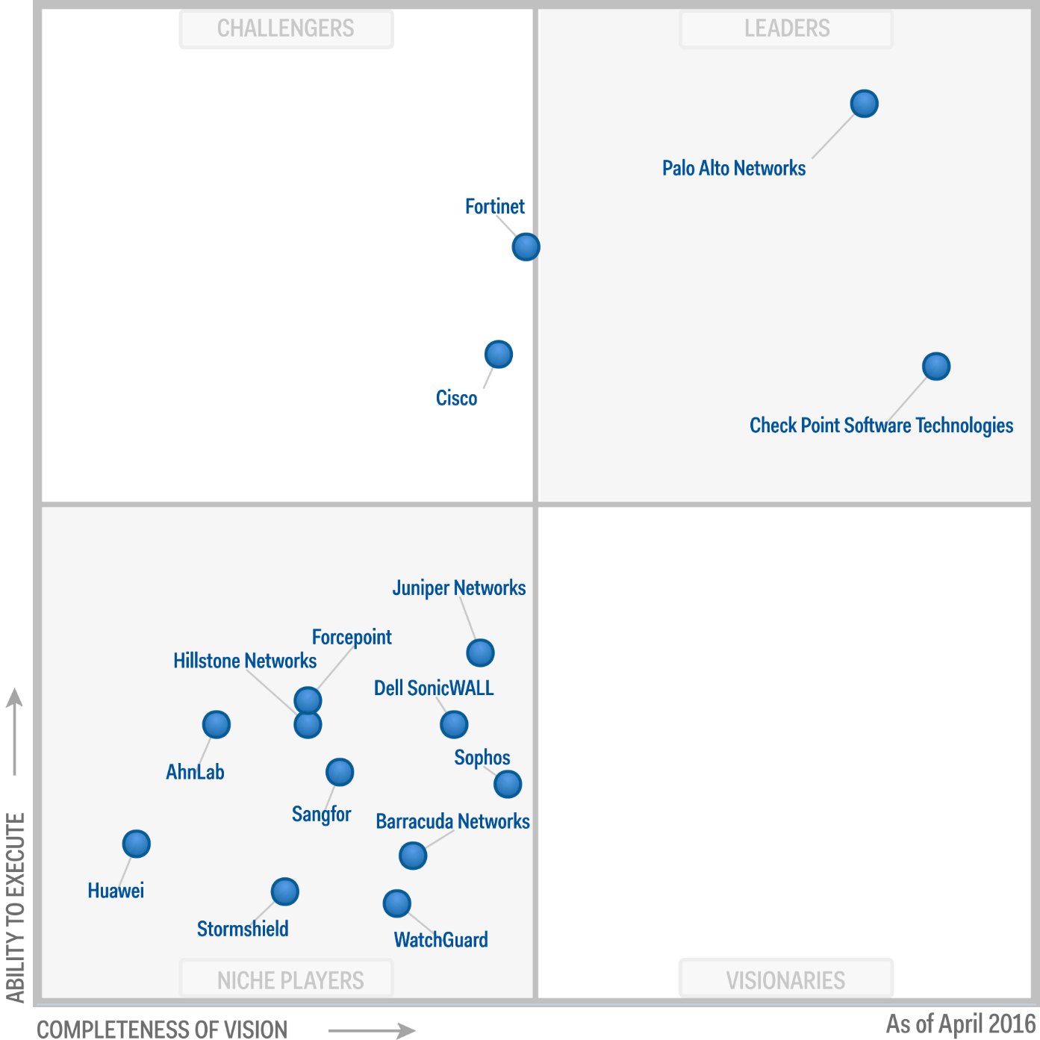
Palo Alto Networks is positioned as a Leader in the Gartner Magic Quadrant for enterprise network firewalls.*
Palo Alto Networks is highest in execution and a visionary within the Leaders Quadrant.
*Gartner Magic Quadrant for Enterprise Network Firewalls, Adam Hils, Greg Young, Jeremy D’Hoinne, and Rajpreet Kaur, May 2016.
Gartner does not endorse any vendor, product or service depicted in its research publications, and does not advise technology users to select only those vendors with the highest ratings or other designation. Gartner research publications consist of the opinions of Gartner's research organization and should not be construed as statements of fact. Gartner disclaims all warranties, expressed or implied, with respect to this research, including any warranties of merchantability or fitness for a particular purpose.
© 2016 Palo Alto Networks. All Rights Reserved.

Slide 4


DELIVERING THE NEXT-GENERATION SECURITY PLATFORM
THREAT INTELLIGENCE CLOUD
Next-Generation Threat Intelligence
Cloud
Next-Generation Firewall
Inspects all traffic
Safely enables applications
Sends unknown threats to cloud
Blocks network based threats
Gathers potential threats from network and endpoints
Analysis and correlates threat intelligence
Disseminates threat intelligence to network and endpoints
AUTOMATED
NETWORK ENDPOINT
CLOUD
NATIVELY INTEGRATED
EXTENSIBLE
Next-Generation Endpoint
NEXT-GENERATION FIREWALL
Inspects all processes and files
Prevents both known and unknown exploits
Protects fixed, virtual, and mobile endpoints
Lightweight client and cloud based
ADVANCED ENDPOINT PROTECTION

Slide 5










Making the Firewall a Business Enablement Tool
Applications: Enablement begins with application classification by App-ID.
Users: Tying users and devices, regardless of location, to applications with User-ID and GlobalProtect.
Content: Scanning content and protecting against all threats, both known and unknown, with Content-ID and WildFire.
Notes:
Lets talk for a moment about how our technology can enable applications, users and content – along with your business.
Safe enablement policies begin with accurate classification of the application using App-ID. App-ID uses a combination of signatures, application and protocol decoders, and heuristics to identify all applications, across all ports, all the time - as soon as traffic hits the firewall. The application identity then becomes the basis for your positive enforcement model firewall policies. This means you can safely allow or block certain applications, or specific functionality within or across multiple applications like file sharing or instant messaging.
Users make up the next piece of a safe enablement policy. We can tie users, regardless of the device platform, to the application with User-ID and GlobalProtect. User-ID integrates with the widest range of directory services on the market, including Active Directory, and Microsoft Exchange (which brings you Linux or MAC-OS users and LDAP to enable you to build policy around users and groups of users by name, not just IP addresses. An API is also available for non-standard directory integration. For remote or traveling employees working on a laptop, an iOS or Android platform from say, a Starbucks or a customer site, we can include them in the safe application enablement policies with our Global Protect end point solution.
Scanning the content within the application is the final enablement policy and that is delivered by Content-ID. IPS, AV, antispyware and URL filtering within Content-ID will allow you to apply very specific threat prevention profiles to your business critical traffic and/or users. The threat prevention engine is stream based and it utilizes a uniform signature format. It looks for a combination of things in a single pass, unlike the silo based AV, IPS and URL filtering. Wildfire provides the ability to identify malicious behaviors typically associated with zero-day attacks found in executable files by running them in a virtual environment and observing their behaviors. When a malicious sample is identified, it is then passed on to the signature generator, which automatically writes a signature for the sample and tests it for accuracy. Signatures are then delivered to all Palo Alto Networks customers as part of the daily malware signature updates.
This slide summarizes one of our Core Value Propositions and Main Differentiators from the other vendors: The ability to SAFELY ENABLE APPLICATIONS, USERS AND CONTENT.
Now, real quick I want to talk about how the device is sold: We sell a purpose built appliance with a purpose built operating system. Included with the base appliance are all the firewall capabilities: App-ID, User-ID, SSL and IPSEC VPN, SSL decryption and re-encryption, QoS, and Data Filtering.
If you are interested in Threat Prevention, URL Filtering – or - Global Protect, these would each require a separate license.
Oh, and just so you are aware…there are no user counts anywhere in our licensing model.
ONE OF THE MAIN POINTS IS TO EMPHASIZE IS THAT WE INNOVATED HEAVILY TO DELIVER ON THE REQUIREMENTS. IT’S A BIG PART OF OUR CULTURE.

Slide 6
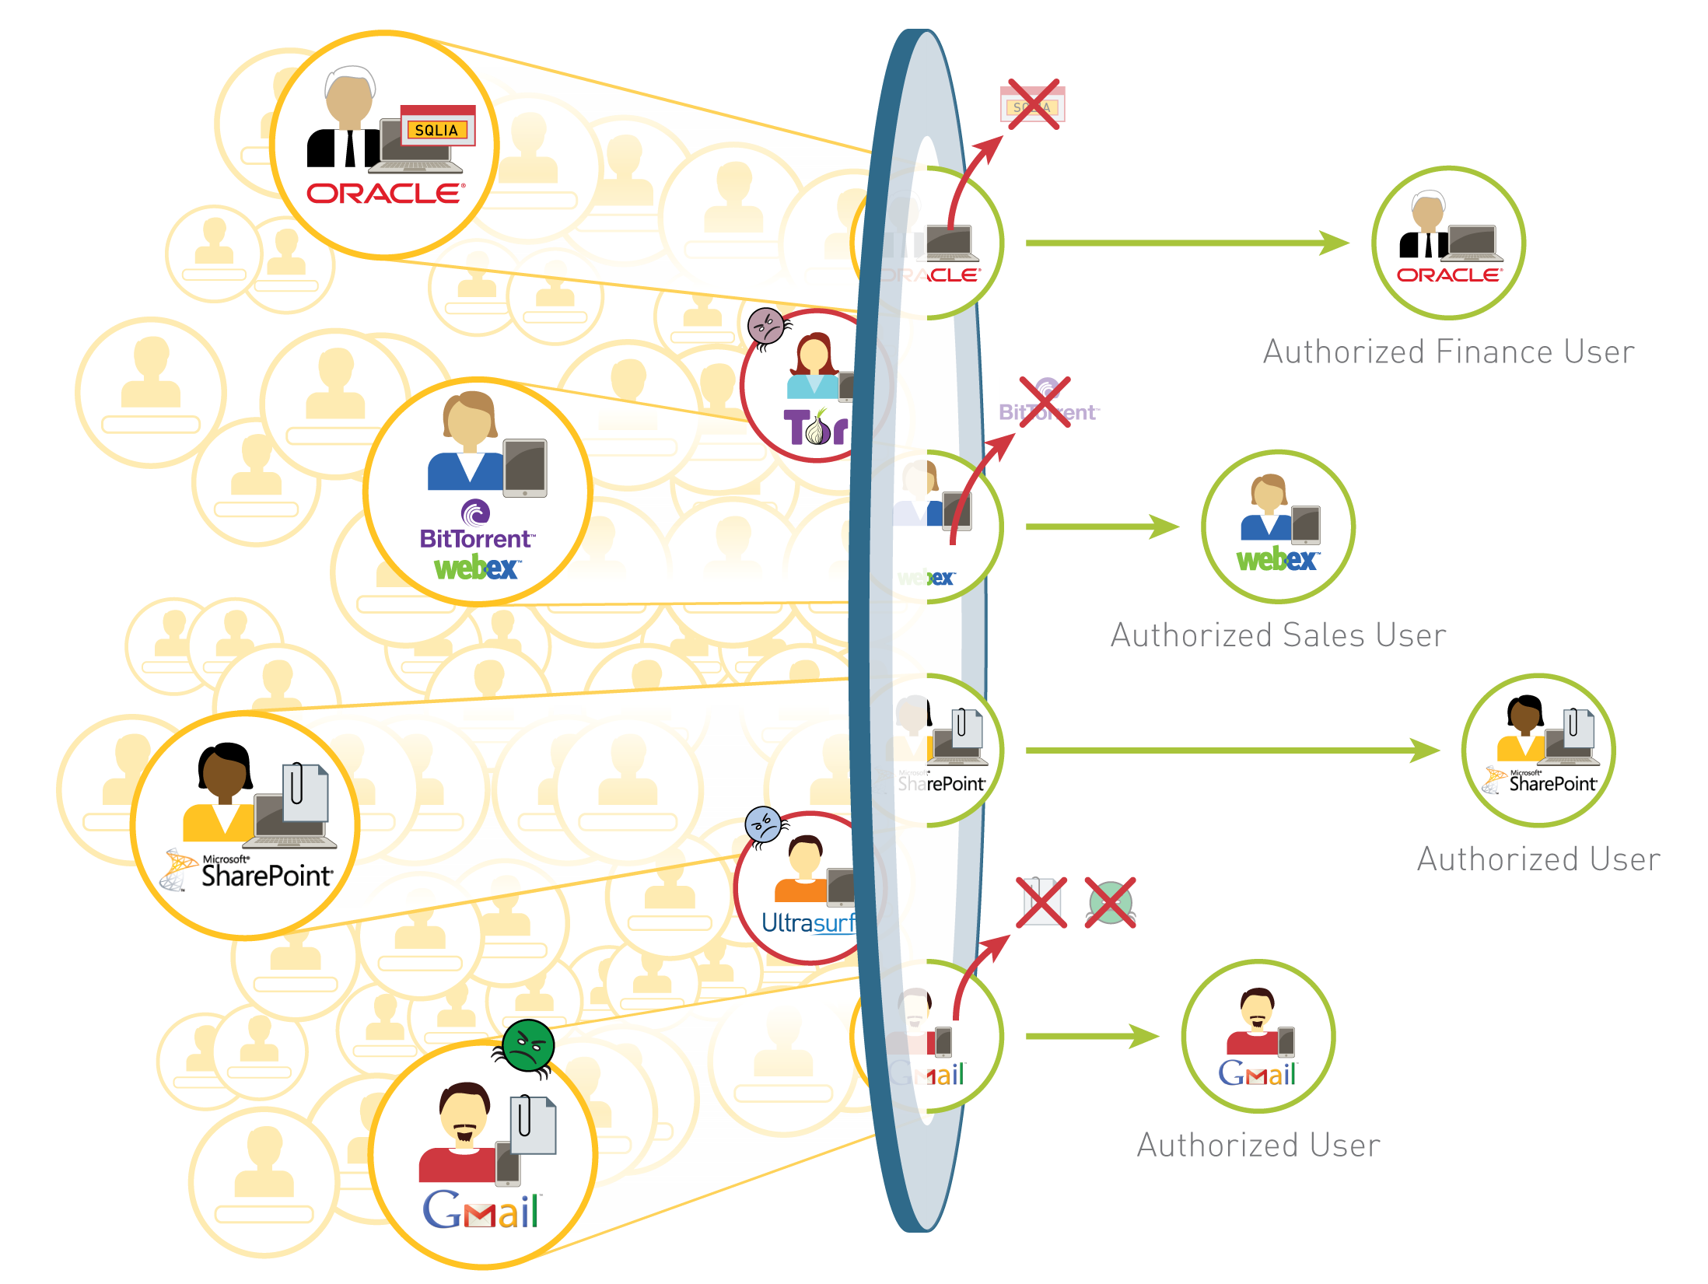
Enabling Applications, Users and Content
Notes:
Palo Alto Networks allows you to build enablement policies that are based on business relevant elements – applications, users and content. It makes perfect sense, right? Your business runs on applications, users and content – shouldn’t your security policies?
At the perimeter, you can reduce your organizations threat footprint by blocking a wide range of unwanted applications and then inspecting the allowed applications for threats - both known and unknown.
<point out gmail, ultrasurf, tor as examples of applications you would allow and scan for threats; or outright block>
In the datacenter, application enablement translates to confirming the applications users and content are allowed and protected from threats while simultaneously finding rogue, misconfigured applications - all at multi-Gbps speeds. In virtualized datacenter environments, organizations can apply consistent application enablement policies while addressing security challenges introduced by virtual machine movement and orchestration.
<point out Oracle and Sharepoint as examples>
Expanding outwards to enterprise branch offices and remote users, enablement is delivered through policy consistency - the same policy deployed at the corporate location and is extended, seamlessly to other locations.
In short, our technology allows you to enable applications for users and protect the associated content – without hindering your business.

Slide 7
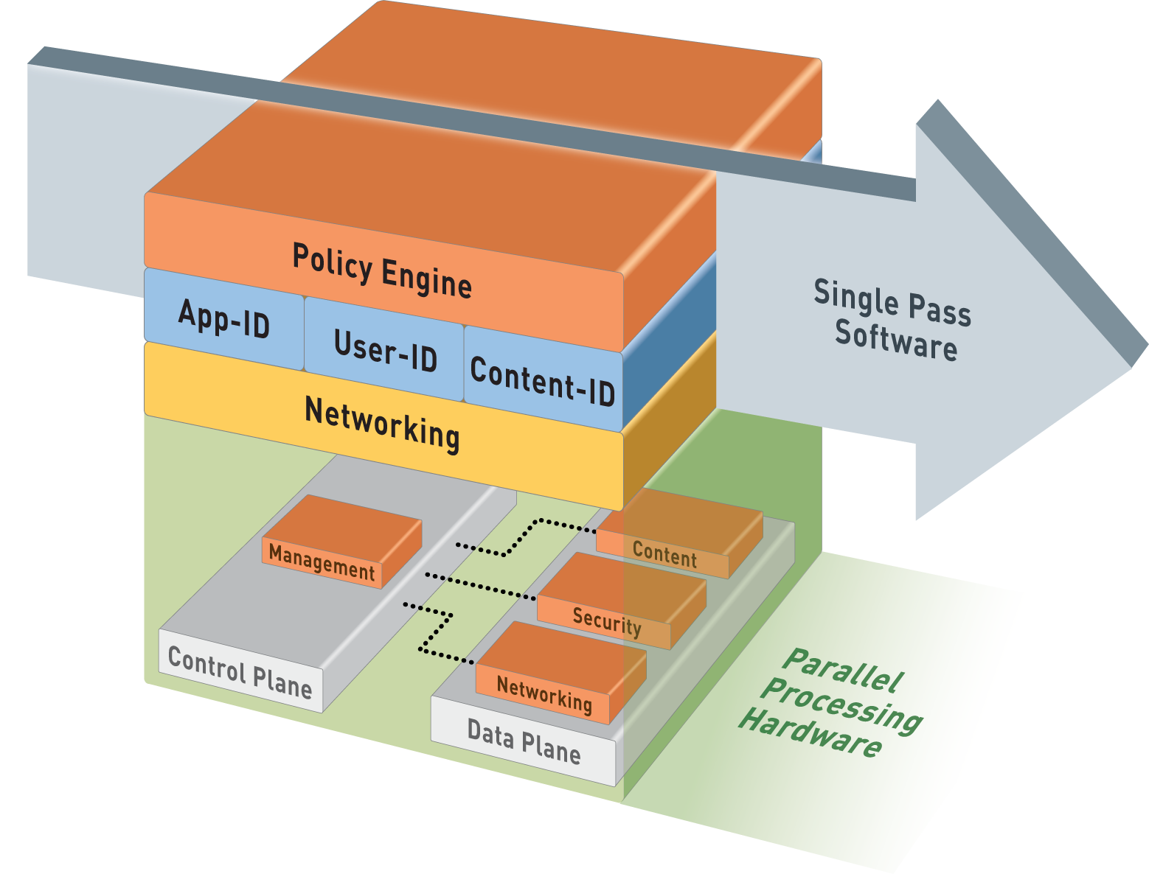
Single-Pass Parallel Processing™ (SP3) Architecture
Single Pass
Operations once per packet
Traffic classification (app identification)
User/group mapping
Content scanning – threats, URLs, confidential data
One policy
Parallel Processing
Function-specific parallel processing hardware engines
Separate data/control planes
7 | ©2014, Palo Alto Networks. Confidential and Proprietary
Notes:
The Palo Alto Networks firewall allows you to specify security policies based on a more accurate identification of each application seeking access to your network. Unlike traditional firewalls that identify applications only by protocol and port number, the firewall uses packet inspection and a library of application signatures to distinguish between applications that have the same protocol and port, and to identify potentially malicious applications that use non-standard ports.
The strength of the Palo Alto Networks firewall is its Single Pass Parallel Processing™ (SP3) engine. Each of the current protection features in the device (Anti Virus, Spyware, Data Filtering and vulnerability protection) utilize the same stream-based signature format. As a result, the SP3 engine can search for all of these risks simultaneously.
The advantage of providing a stream based engine is that the traffic is scanned as it crosses the box with a minimal amount of buffering.
For further explanation, refer to the document Single_Pass_Parallel_Processing_Architecture.pdf on the Palo Alto Networks website.

Slide 8















PREVENTION AGAINST UNKNOWN THREATS
Anti-malware signatures
DNS intelligence
Malware URL database
Anti-C2 signatures
3
SIGNATURE CREATION
2
SANDBOX
TESTING
4
Soak sites, sinkholes,
3rd party sources
Global intelligence and protection shared with all customers
WildFire
TM
Command-and-control
Staged malware downloads
Host ID and data exfil
1
SUSPICIOUS
TRAFFIC
Palo Alto Networks Customers

Slide 9

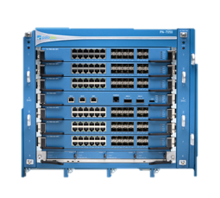


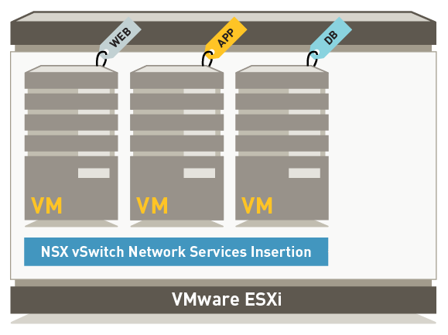

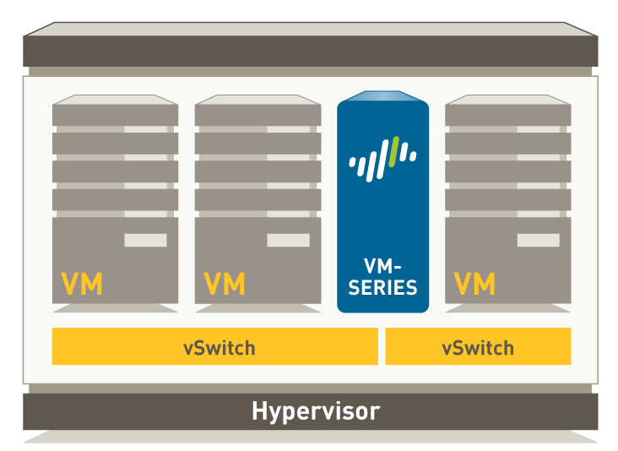



Protecting all data center traffic
Security
Network
Application
Orchestration systems
corporate network/DMZ
Securing North South traffic
Securing East West traffic
Segment North South (physical) and East West (virtual) traffic
Tracks virtual application provisioning and changes via dynamic address groups
Automation and orchestration support via REST-API
Virtualized servers
Physical servers

Slide 10


Exploit Techniques
Exploit Attack
Exploit Technique
2
1. Exploit attempt contained in a PDF sent by “known” entity.
Begin
Malicious Activitiy
2. PDF is opened and exploit techniques are set in motion to exploit vulnerability in Acrobat Reader.
3. Exploit evades AV and drops a malware payload onto the target.
Exploit Technique
1
Exploit Technique
3
4. Malware evades AV, runs in memory.
Normal Application Execution
Activate key logger
Steal critical data
More…
Gaps Are Vulnerabilities
Notes:
To gain a better understanding of these exploit techniques and how they are used by attackers, let’s walk through an example:
The graphic here represents an application – Adobe acrobat reader, for example. As with most applications, this application has a certain number of vulnerabilities. Some may be known, in which case patches might be available. Other vulnerabilities have yet to be discovered.
The application normally runs its normal functions (for example, display a document, print, etc.).
The attacker’s goal is to cause the application to do something it is not meant to do (ie, run a piece of code supplied by the attacker). In order to make that happen, the attacker needs to use a series of exploit techniques, in a particular order. If those techniques succeed, the attacker can exploit a vulnerability in the application.
So the user in this example opens the PDF document, the document displays as it normally would, but in the background these techniques are set in motion.
Click forward, showing the 3 exploit techniques…
If all three of these techniques succeed (and they often do because anti-virus is not good at detecting them), the acrobat reader software is exploited and malware can be executed.
Click forward to “Begin Malicious Activity”

Slide 11
Exploit Techniques
Exploit Attack
1. Exploit attempt contained in a PDF sent by “known” entity.
2. PDF is opened and exploit techniques are set in motion to exploit vulnerability in Acrobat Reader.
3. Exploit evades AV and drops a malware payload onto the target.
4. Malware evades AV, runs in memory.
Exploit Technique
Blocked
Normal Application Execution
Traps Exploit Prevention Modules (EPM)
Traps EPM
1. Exploit attempt blocked. Traps requires no prior knowledge of the vulnerability.
Notes:
Now let’s look at the same scenario again, this time with our Traps Exploit Prevention Modules in place.
Our Traps Advanced Endpoint Protection agent runs on the endpoint and injects these exploit prevention modules into each application that runs. This process is seamless and transparent to the end-user.
Note that the exploit prevention modules require no knowledge of where the vulnerabilities are in the application. So you are protected from exploitation of both known and unknown vulnerabilities.
Click forward: Exploit Technique Blocked.
As you can see, as soon as the exploit technique is attempted, it is blocked by Traps. At this point Traps would terminate the application and send a notification to the end-user and the administrator console with detailed information about the attempted attack.
No malicious code was allowed to execute so no harm has been done.
Now – You might be wondering: “What if the attacker invents a new exploit technique? Or What if the attacker is able to circumvent one of the exploit prevention modules?” Click forward…

Slide 12

Exploit Techniques
Exploit Technique
Blocked
Exploit Attack
1. Exploit attempt contained in a PDF sent by “known” entity.
No Malicious Activity
2. PDF is opened and exploit techniques are set in motion to exploit vulnerability in Acrobat Reader.
3. Exploit evades AV and drops a malware payload onto the target.
4. Malware evades AV, runs in memory.
Exploit Technique
1
Normal Application Execution
Traps Exploit Prevention Modules (EPM)
Traps EPM
1. Exploit attempt blocked. Traps requires no prior knowledge of the vulnerability.
2. If you turn off EPM #1, the first technique will succeed but the next one will be blocked, still preventing malicious activity.
Notes:
As mentioned previously, an attack will only be successful if a series of exploit techniques succeed – usually 3-5.
So let’s walk through the scenario where the first exploit prevention module is bypassed and Exploit technique #1 succeeds.
Click
Click again to the second exploit technique being blocked.
Due to the chain-like nature of exploit techniques, even if one succeeds, the next one will be blocked. This will break the chain and prevent successful exploitation of the vulnerable application. So despite the fact that one technique succeeded, the exploit still failed and no malicious activity occurred on the system..
Click – “No Malicious Activity” comes up and the file type starts changing from PDF to other types
Remember, we use adobe acrobat as an example here but this can be any application, including proprietary applications. The nature of the Traps exploit prevention modules is such that they do not require any prior knowledge of the application, how it works, or its vulnerabilities.

Slide 13






SAFELY ENABLE APPLICATIONS
Cloud
FACILITATE ACCESS
DATA
CENTER
REDUCE AND CONTROL RISK
Remove threats from wanted traffic
Allow desired applications by user,
limit high-risk features
Visibility into all applications & users
on the network

Slide 14
DELIVERING THE NEXT-GENERATION SECURITY PLATFORM
THREAT INTELLIGENCE CLOUD
Next-Generation Threat Intelligence
Cloud
Next-Generation Firewall
Inspects all traffic
Safely enables applications
Sends unknown threats to cloud
Blocks network based threats
Gathers potential threats from network and endpoints
Analysis and correlates threat intelligence
Disseminates threat intelligence to network and endpoints
AUTOMATED
NETWORK ENDPOINT
CLOUD
NATIVELY INTEGRATED
EXTENSIBLE
Next-Generation Endpoint
NEXT-GENERATION FIREWALL
Inspects all processes and files
Prevents both known and unknown exploits
Protects fixed, virtual, and mobile endpoints
Lightweight client and cloud based
ADVANCED ENDPOINT PROTECTION

Slide 15

Thank you!

